Slide 1

Rest API Automation (Web service testing)

Slide 2

About trainer
8+ years of experience in IT Industry
Worked for WIPRO ,CTS, Accenture
Published 13+ whitepapers in Automation
Developed Enterprise business solution for various client
Expertise in both Development and QA
Expert in C#, Java, Python, Java Script, Node JS
Trained more than 500+ Students
RPA Developer
(UIPATH,BluePrisim,AA)
Master Of Science From BITS PILANI

Slide 3


transformation

Slide 4
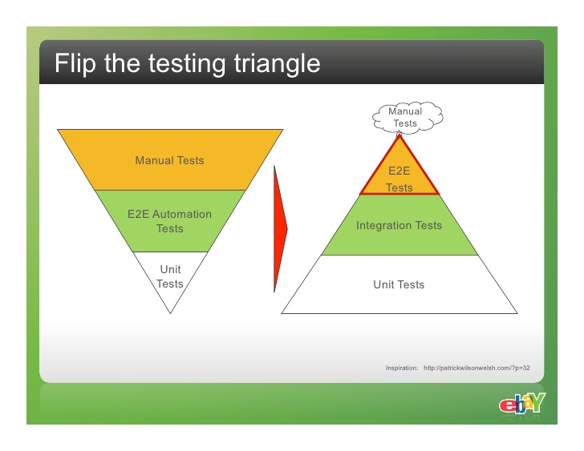
Testing triangle

Slide 5

Two different systems communications
“JABONG” ---- Java
ICICI---C#
Canara—Python
SBI---Ruby
AXIS--PHP

Slide 6
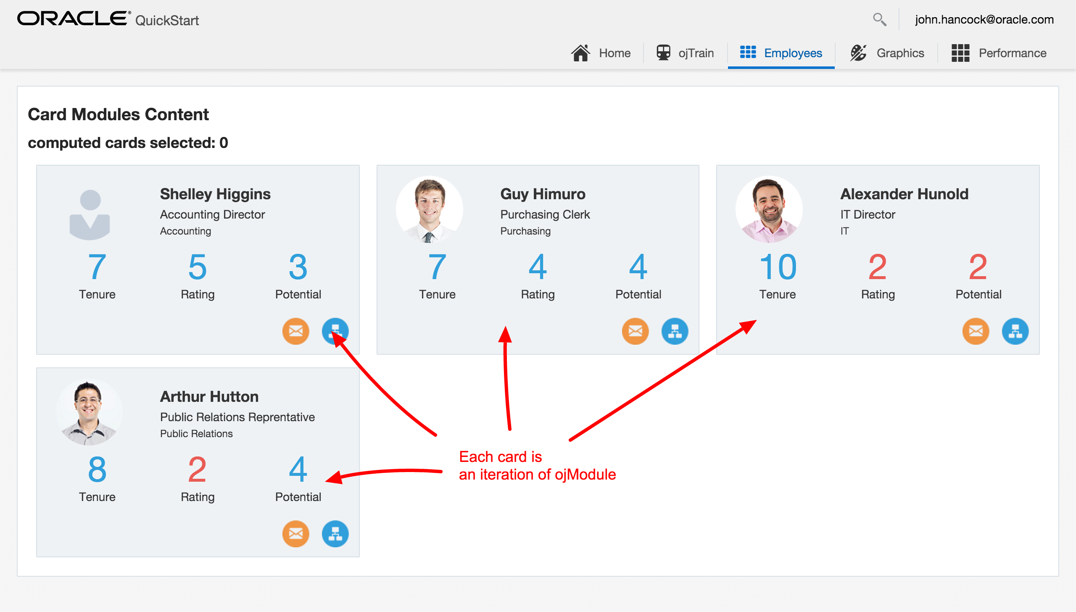
Passing data from module to module

Slide 7

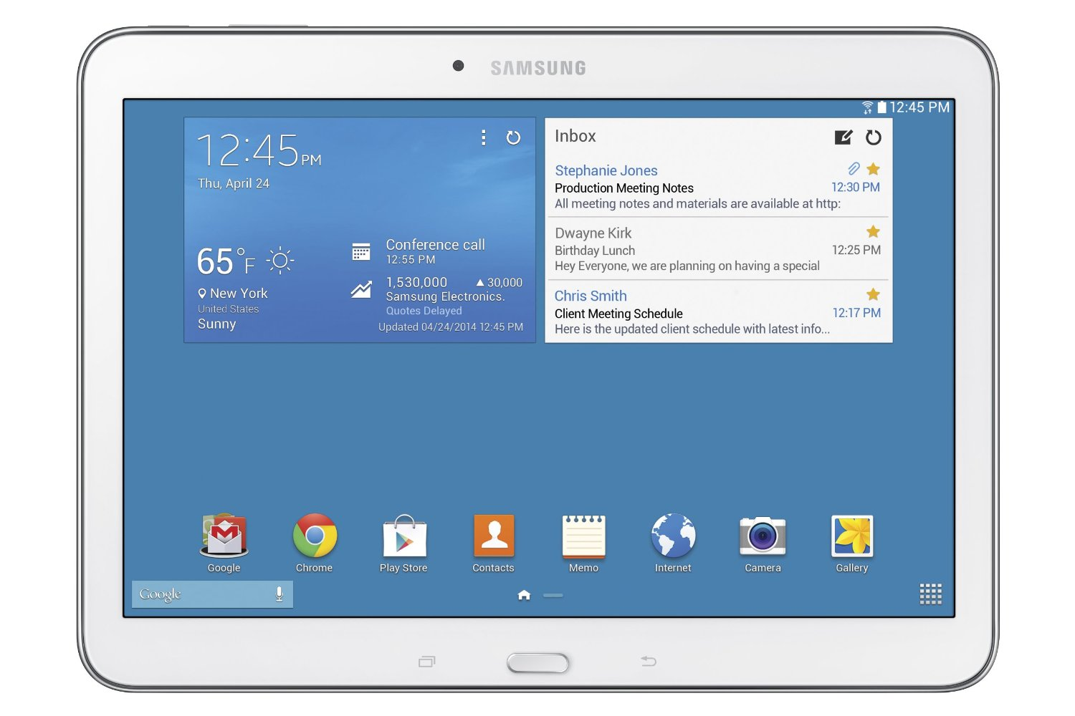



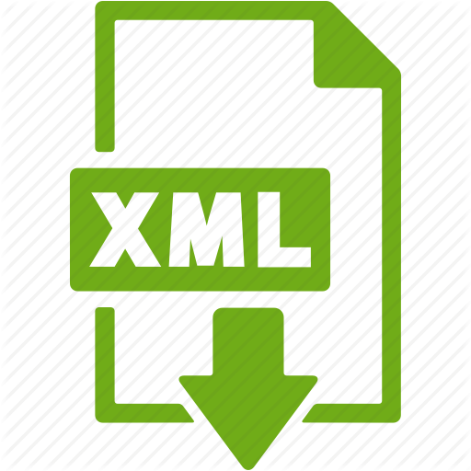
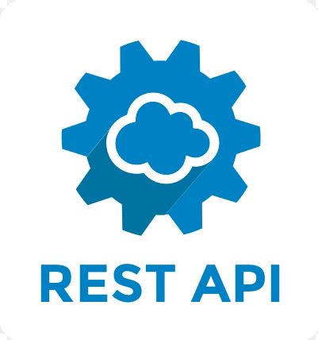


Insight into rest services

Slide 8




Tools for api testing

Slide 9




Rest assured
REST Assured is a Java DSL for simplifying testing of REST based services built on top of HTTP Builder. It supports POST, GET, PUT, DELETE, OPTIONS, PATCH and HEAD requests and can be used to validate and verify the response of these requests.

Slide 10
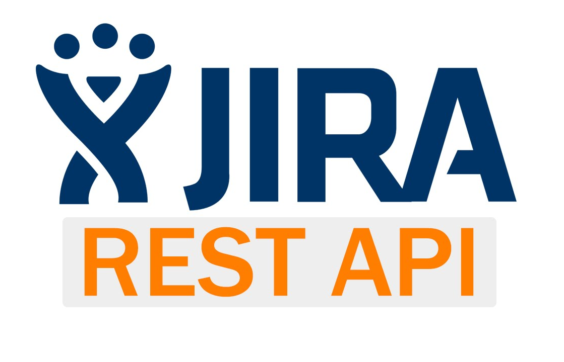



Open source api

Slide 11
Course details
Course Duration: 40-45 days
Programing Language: Java
Tools :POSTMAN or SOAP UI
Frame Work: Scratch Level Development using Test NG
Artifacts:
End of this course you will be provided with Framework and Softcopy of the material
Daily Programs will be avaialabe in Testing Masters Git Hub repository

